Slide 1
DEEP LEarNiNg MastEr Class
Day-9

Slide 2
01
Optimizers
Concept

Slide 3
Disadvantage in gradient descent
Small learning Rate leads to slow convergence
Large learning rate leads to hinder convergence
Reducing learning rate according to pre-defined schedule unable to adapt to a dataset’s characteristic
Same learning rate applies to all parameter updates, even we have different frequencies of features
Variations of GD
Momentum
Nesterov Accelerated Gradient
Adagrad
Adadelta/RMSProp
Adam

Slide 4
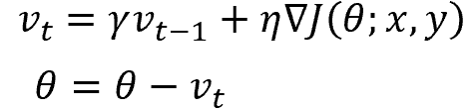
Momentum
Momentum helps accelerate Gradient Descent(GD) when we have surfaces that curve more steeply in one direction than in another
For updating the weights it takes the gradient of the current step as well as the gradient of the previous time steps
This helps us move faster towards convergence
Convergence happens faster when we apply momentum optimizer to surfaces with curves
Momentum Gradient descent takes gradient of previous time steps into consideration

Slide 5
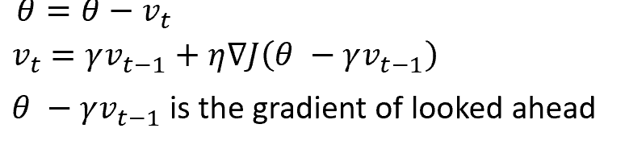
Nesterov accelerated gradient(NAG)
Nesterov acceleration optimization is like a ball rolling down the hill but knows exactly when to slow down before the gradient of the hill increases again.
We calculate the gradient not with respect to the current step but with respect to the future step
We evaluate the gradient of the looked ahead and based on the importance then update the weights
Works slightly better than standard Momentum

Slide 6
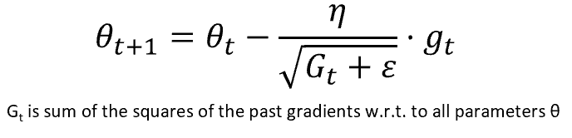
Adagrad — Adaptive Gradient Algorithm
We need to tune the learning rate in Momentum and NAG which is an expensive process
Adagrad is an adaptive learning rate method
In Adagrad we adopt the learning rate to the parameters
We perform larger updates for infrequent parameters and smaller updates for frequent parameters.
For SGD, Momentum, and NAG we update for all parameters θ at once. We also use the same learning rate η. In Adagrad we use different learning rate for every parameter θ for every time step t
Adagrad eliminates the need to manually tune the learning rate.

Slide 7
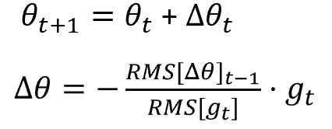
Adadelta
Adadelta is an extension of Adagrad and it also tries to reduce Adagrad’s aggressive, monotonically reducing the learning rate
It does this by restricting the window of the past accumulated gradient to some fixed size of w. Running average at time t then depends on the previous average and the current gradient
In Adadelta we do not need to set the default learning rate as we take the ratio of the running average of the previous time steps to the current gradient

Slide 8
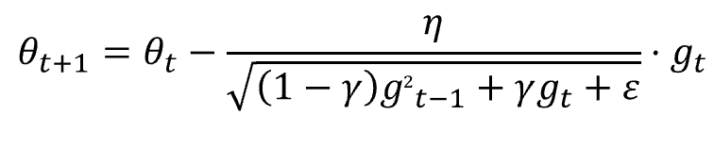
RMSProp
Root Mean Square Propagation
RMSProp tries to resolve Adagrad’s radically diminishing learning rates by using a moving average of the squared gradient
It utilizes the magnitude of the recent gradient descents to normalize the gradient
In RMSProp learning rate gets adjusted automatically and it chooses a different learning rate for each parameter
It divides the learning rate by the average of the exponential decay of squared gradients

Slide 9
Adam — Adaptive Moment Estimation
Another method that calculates the individual adaptive learning rate for each parameter from estimates of first and second moments of the gradients
It also reduces the radically diminishing learning rates of Adagrad
It can be viewed as a combination of Adagrad, which works well on sparse gradients and RMSprop which works well in online and nonstationary settings
Adam implements the exponential moving average of the gradients to scale the learning rate instead of a simple average as in Adagrad. It keeps an exponentially decaying average of past gradients
Adam is computationally efficient and has very little memory requirement
Adam optimizer is one of the most popular gradient descent optimization algorithms

Slide 10
Deep Learning Terminology - 1
LSTM
LSTM stands for Long short-term memory
LSTM has feedback connections which makes it a "general purpose computer.“
It can process not only a single data point but also entire sequences of data.
They are a special kind of RNN which are capable of learning long-term dependencies.
Step 1: The network decides what to forget and what to remember.
Step 2: It selectively updates cell state values.
Step 3: The network decides what part of the current state makes it to the output.

Slide 11
Deep Learning Terminology - 2
Autoencoder
Autoencoder is an artificial neural network. It can learn representation for a set of data without any supervision.
The network automatically learns by copying its input to the output
They can learn efficient ways of representing the data
It contains three layers:
Encoder - is used to compress the input into a latent space. It encodes the input images as a compressed representation in a reduced dimension. The compressed images are the distorted version of the original image.
Decoder - The decoder layer decodes the encoded image back to its original dimension. The decoded image is a reduced reconstruction of the original image

Slide 12
Deep Learning Terminology - 3
Bagging and Boosting
Bagging and Boosting are ensemble techniques to train multiple models using the same learning algorithm and then taking a call.
With Bagging, we take a dataset and split it into training data and test data. Then we randomly select data to place into the bags and train the model separately.
With Boosting, the emphasis is on selecting data points which give wrong output to improve the accuracy.

Slide 13
Ways to have more time
Short bytes – D9
Decide what’s important and do it 1st Everyday
Don’t let other people schedule your life
Pay close attention to what makes you happy
Stop watching TV
Schedule your breaks and Enjoy them
Look through ur Calendar & Cancel things you aren’t excited about
If you keep putting something off just let it go
Before you go to bed decide on tomorrow’s most important action

Slide 14
Thanks!
Thanks!
Follow Me on LinkedIn : Link in Description
+91 7305845758
Pantechsolutions.net
Ask Your Friends to Participate on this Event

